Slide 1
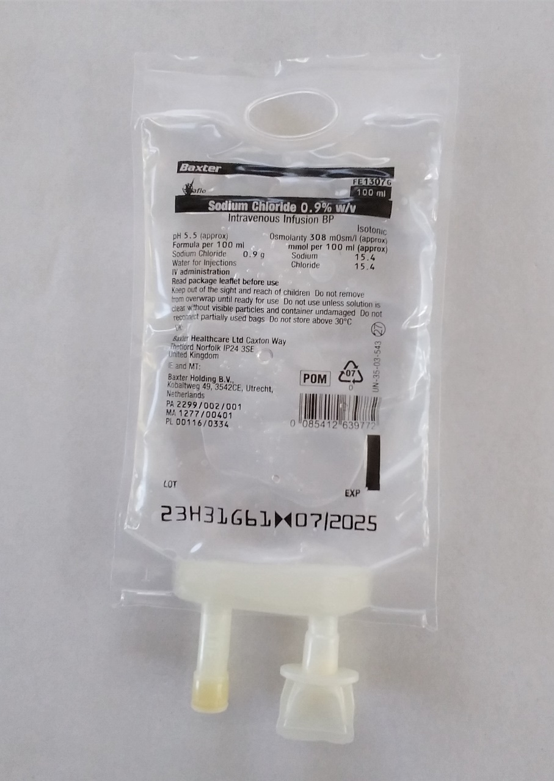
SAMPLE IV Infusion Bag (may not be the one used at all OSCEs but use as a guide)
Eyelet for hanging IV bag
on drip-stand
Volume of
infusion bag
Name of IV
infusion medication
Expiry date
Ingredients
Fluid outlet port
Plastic twist-off protector cap
Must be removed before inserting
IV infusion line spike. Remove the
protector cap from IV bag before
removing cover of IV line spike –
less risk of contaminating spike
Re-sealable
medication
injection port

Slide 2
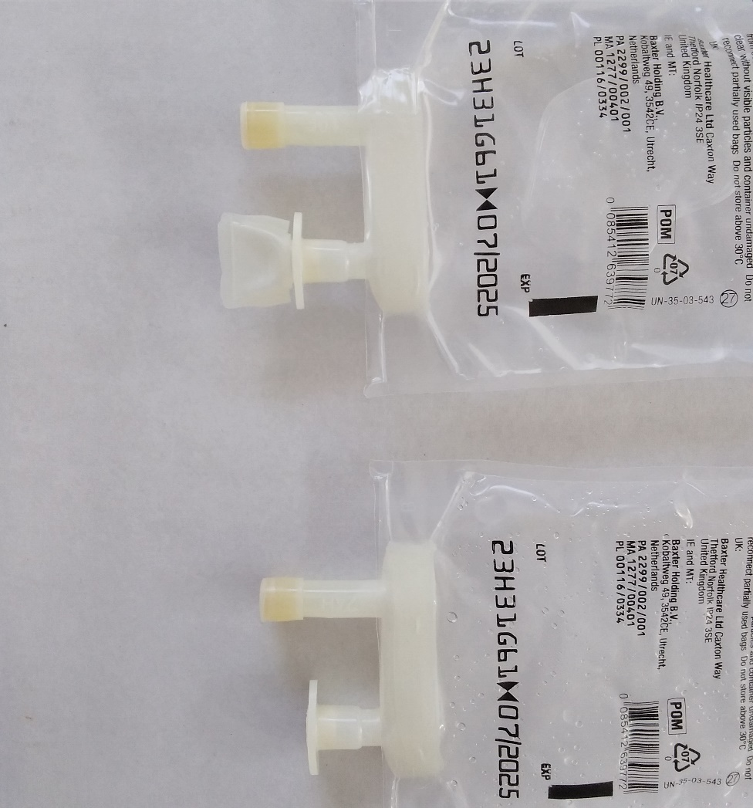
Removing protector cap and spiking IV bag (may not be the one used at all OSCEs but use as a guide)
Protector cap on & off
Safely spiking IV infusion bag
Hang infusion bag from drip stand
Twist off the protector cap from the outlet port of IV fluid bag
Remove spike-protector from the spike of IV administration set
Take care to avoid contaminating any of the sterile key parts
Use a twisting motion to fully insert spike of administration set into outlet port of fluid bag
A slight resistance should be felt as the port membrane is broken when spike enters the bag
Do not fold the fluid bag during spike insertion to avoid piercing bag

